Slide 1

GAME PROGRAMMING IN C++
2020
Notes:
Ovo je prvi čas držan iz karantina, online, zato ima na drugom i trećem slajdu rešenje zadatka sa prošlog časa, onog zadatka koji je trebalo raditi na ovom času da se desio u učionici

Slide 2
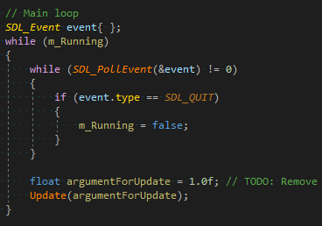
Main loop

Slide 3
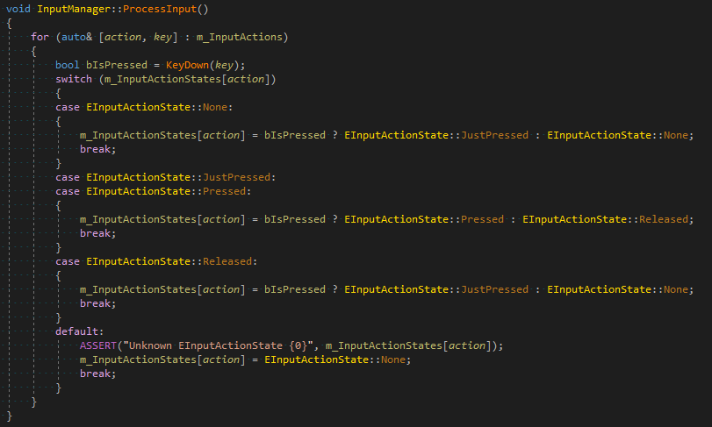
Input Manager

Slide 4
Precompiled Headers
Header
Ne kompajlira se direktno
#include-uje se u druge fajlove
Veliki broj čestih includeova povećava trajanje kompilacije
Spojiti i isprocesiratete include-ova kako bi se ubrzala kompilacija
https://blog.knatten.org/2010/10/29/what-i-have-against-precompiled-headers/
Notes:
Often large projects have many header files that are included in every source file. The time the compiler takes to process these header files over and over again can account for nearly all of the time required to build the project. To make builds faster, compilers allows you to precompile a header file.
If you examine the *.cpp files in your project, you will notice that many of them include the same sets of headers, for example <vector>, <string>, <algorithm>. These headers, in their turn, include other headers, and so on.
All this results in the compiler’s preprocessor doing the same work again and again – it must read the same files many times, insert them into each other, process #ifdef, and expand macros. Because of this, the same operations are repeated a huge number of times.
The amount of work the preprocessor has to do during project compilation can be greatly reduced. The idea is to preprocess a group of files in advance, and then simply insert already prepared text fragments where necessary.
It actually includes a few more steps; instead of simple text, you can store more highly processed information.

Slide 5
Linearn algebra u C++
Ne postoji u standardu
Linear algebra proposal: http://www.open-std.org/jtc1/sc22/wg21/docs/papers/2019/p1385r1.html - Možda u C++23
U međuvremenu, biblioteke
glm, eigen, hlsl++, uBLAS, etl, blaze, Armadillo
Notes:
Pošto pravimo samo 2D igru koristeći SDL, nije nam potrebno mnogo linearne algebre. Ali nemamo podršku ni za Point, a ne želimo da pišemo funkcije za to po hiljaditi put

Slide 6
GLM
OpenGL Mathematics (GLM) is a header only C++ mathematics library for graphics software based on the OpenGL Shading Language (GLSL) specifications.
GLM provides classes and functions designed and implemented with the same naming conventions and functionalities than GLSL so that anyone who knows GLSL, can use GLM as well in C++.
Used by by including the <glm/glm.hpp> header

Slide 7

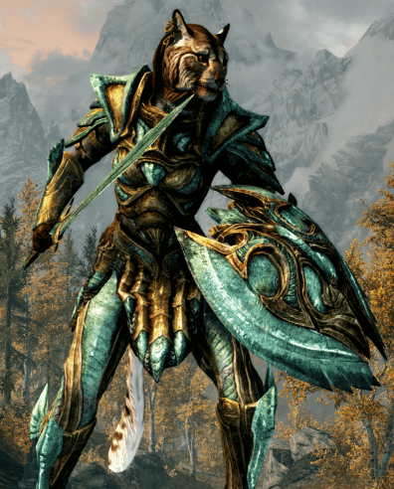
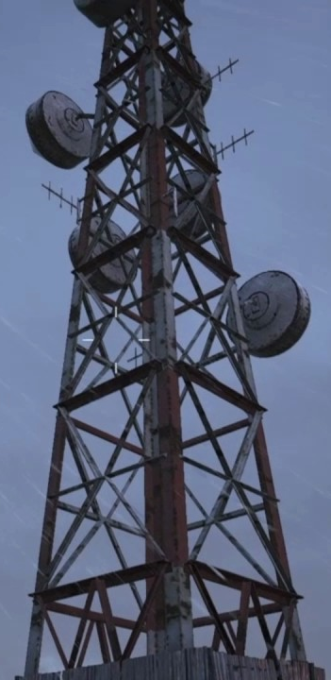
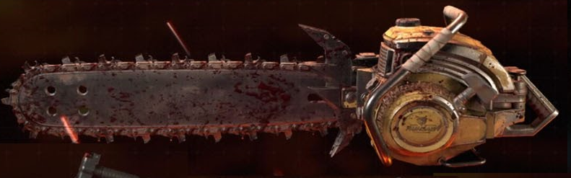

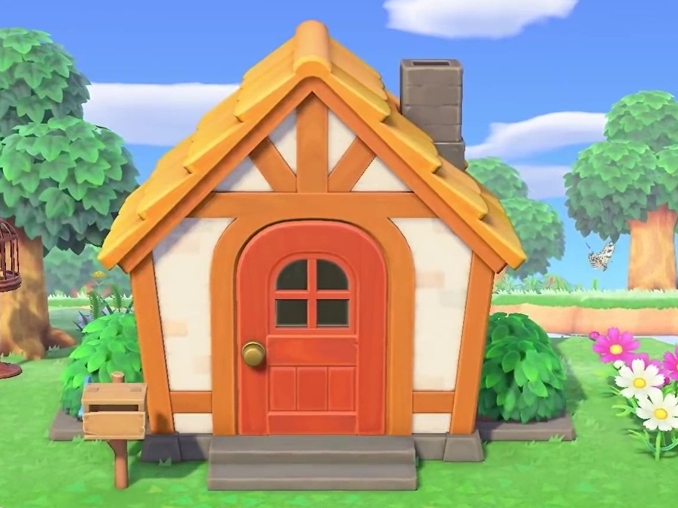



Entity Component System
Šta je Entitet?

Slide 8
Šta je entitet?
Objekat u svetu
Može (a ne mora) biti:
vidljiv
pokretljiv
agresivan
eksplodirajuć
naciljan
klikabilan (?)
pametan
…….
Pojam entiteta se pojavljuje u svim žanrovima igara

Slide 9
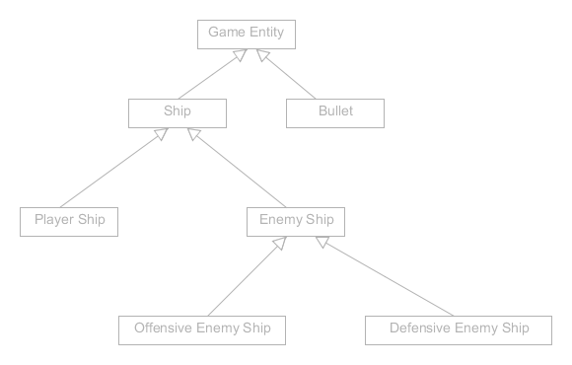
OOP arhitektura entiteta
Notes:
The traditional way to implement game entities was to use object-oriented programming. Each entity was an object, which intuitively allowed for an instantiation system based on classes and enabled entities to extend others through polymorphism.

Slide 10
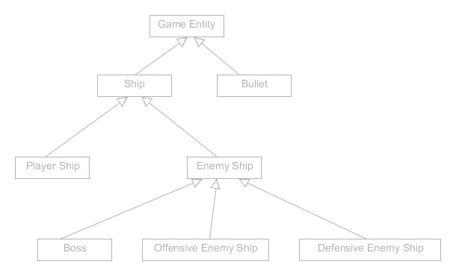
OOP arhitektura entiteta
Notes:
Boss je brod koji je i offensive i defensive
Problem: Copy paste funkcionalnosti

Slide 11
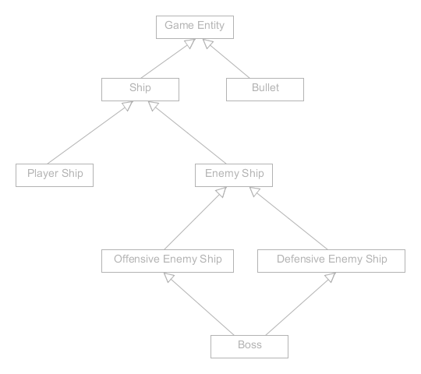
OOP arhitektura entiteta
Notes:
Problem: Diamond inheritance

Slide 12
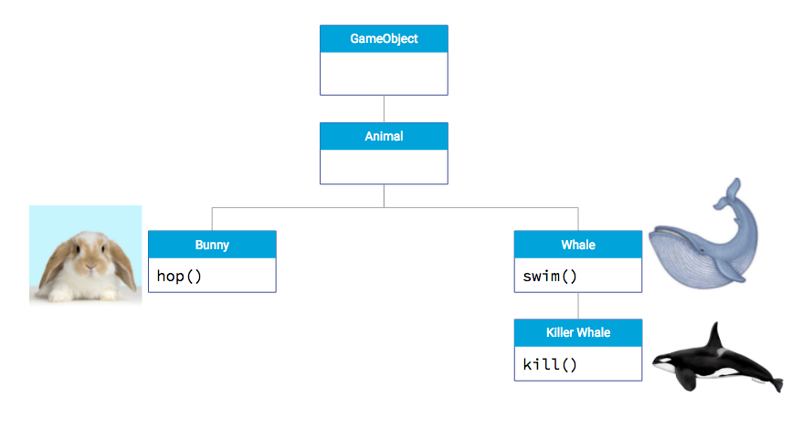
OOP arhitektura entiteta

Slide 13
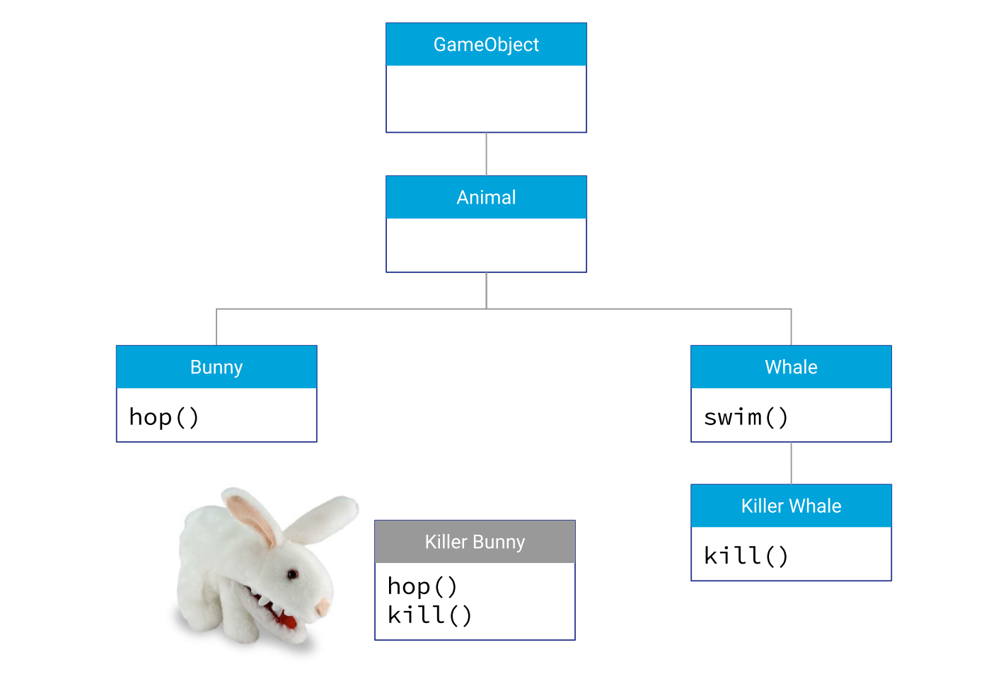
OOP arhitektura entiteta
Notes:
Problem: Diamond inheritance

Slide 14
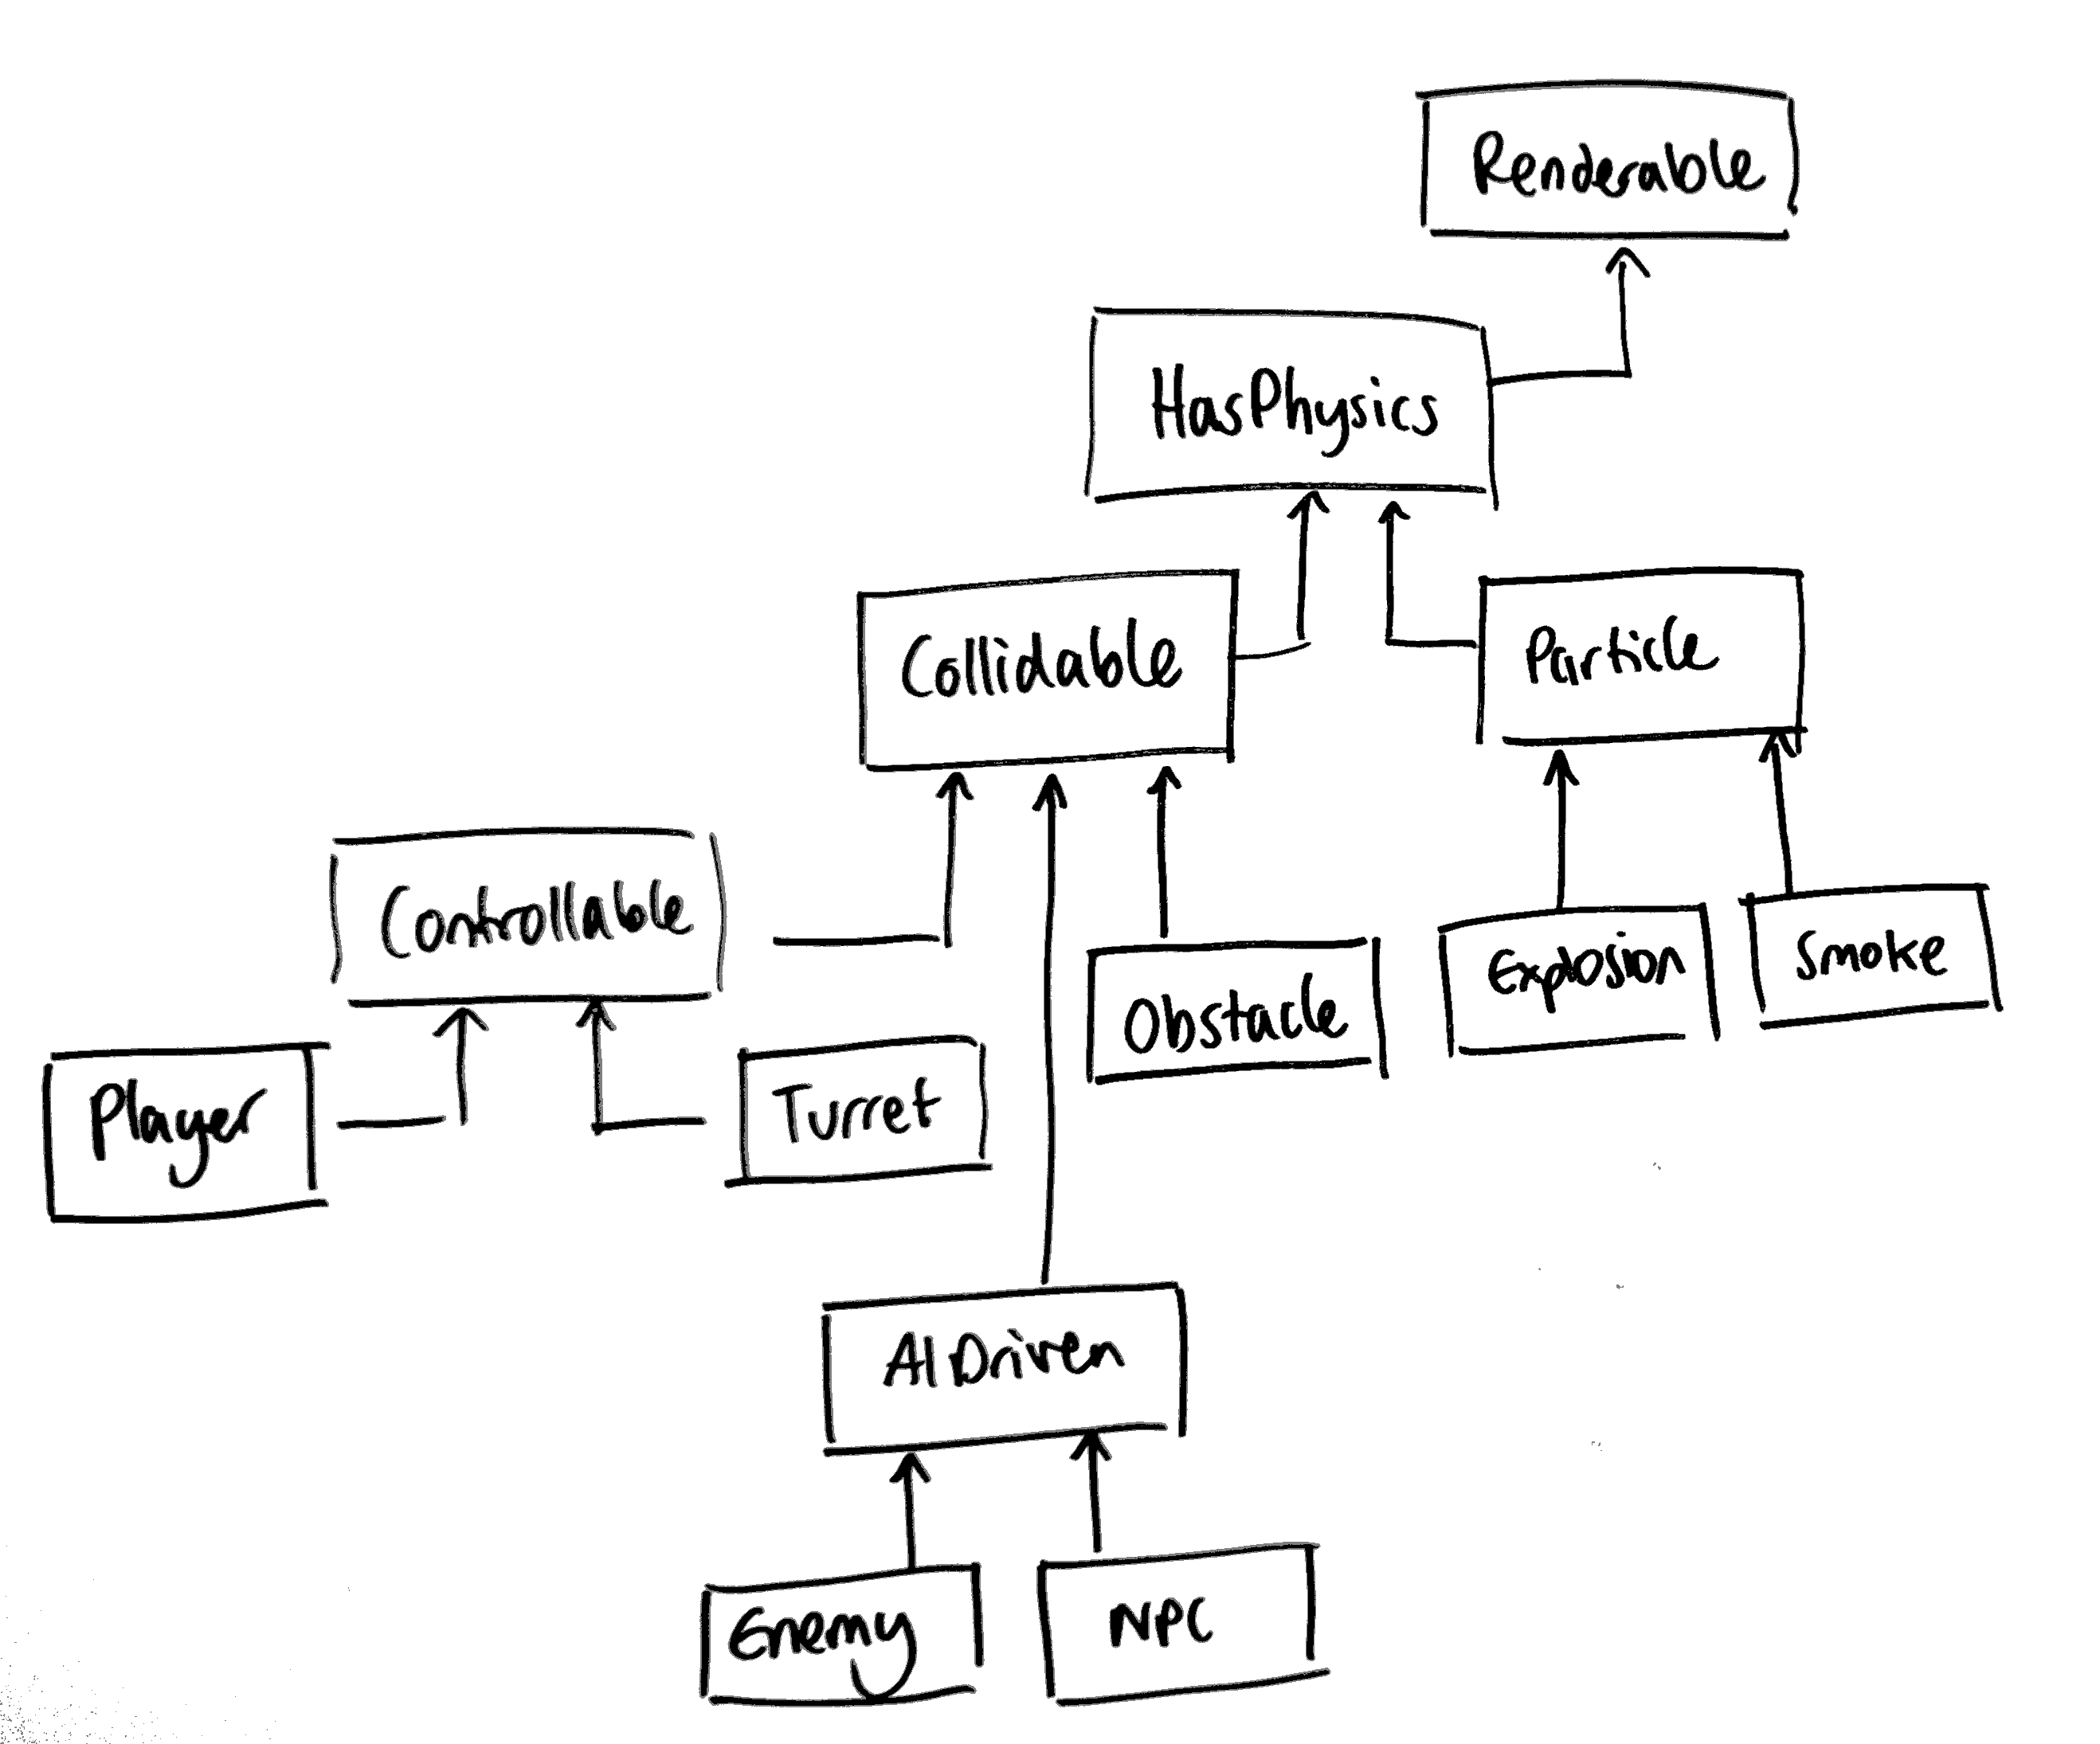
OOP arhitektura entiteta
Notes:
Problem: Overreliance on inheritance, deep inheritance tree

Slide 15
OOP arhitektura entiteta
Entitet je bazna klasa
Klasa Entitet i klase koje je nasleđuju sadrže osnovnu logiku igre i podatke o stanju igre
Velike klase
Često dodajemo virtuelne funkcije (prazne!) u baznu klasu samo da bismo mogli da podržimo funkcionalnost koja nama treba u izvedenim klasama
Kod koji dodajemo u najniže izvedene klase često moramo da kopiramo da bismo izbegli diamond inheritance
Mnogi sistemi ne pripadaju jednom objektu
Kolizije, AI…
Notes:
This is not to say that you shouldn’t use OOP or that OOP is bad. However, this is one bad way to use OOP as it relies on overuse of inheritance and breaking of SOLID and other C++ „rules“ (e.g. composition over inheritance).
C++ is a general-purpose programming language, you can of course write OOP, but it also has many features that enable writing of generic code (e.g. static polymorphism) and functional code (e.g. Functional Programming in C++ - Ivan Čukić)
There are hybrid systems that use inheritance in combination with composition that are widely used.

Slide 16
OOP arhitektura entiteta
Duboke i rigidne hijerarhije
Moramo da poznajemo sve klase iz kojih nasleđujemo
Nemoguće je osigurati se da se metode bazne klase pozivaju iz nasleđene klase
Provešćete celo veče debagujući jedan base.Update() koji fali negde.
Mnogo virtuelnih poziva
Teško za multithreading

Slide 17
OOP arhitektura entiteta
http://whats-in-a-game.com/implementation-inheritance-is-evil/
https://channel9.msdn.com/Events/GoingNative/2013/Inheritance-Is-The-Base-Class-of-Evil
https://www.gamedev.net/blogs/entry/2265481-oop-is-dead-long-live-oop/
Notes:
Like everything else in programming, there is no real concensus on the proper way to do things. You’ll have to do a lot of trial and error and standing on the shoulders of giants. These are some useful links talking about overuse and proper use of OOP

Slide 18
— Mike Acton
The purpose of all programs, and all parts of those programs, is to transform data from one form to another.”
“If you don’t understand the data, you don’t understand the problem.”
"Data-Oriented Design and C++”, CppCon 2014, https://www.youtube.com/watch?v=rX0ItVEVjHc
Notes:
Does Code and Data need to go together?
●Typical OO puts both Code and Data together in one class
●Why, though?
●How often do you have oneof a particular thing?
●In games, most common cases are:
●There’s a handful of things. Any code will work here.
●There’s way too many things. Have to be careful with performance.

Slide 19
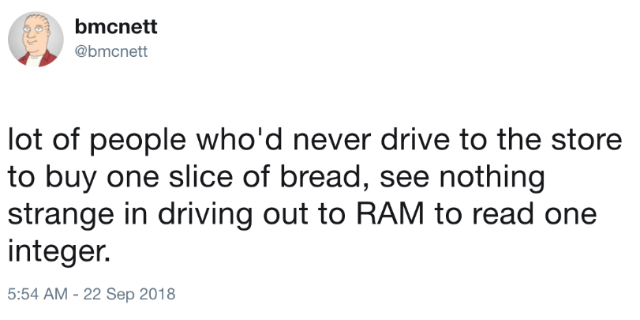

Slide 20
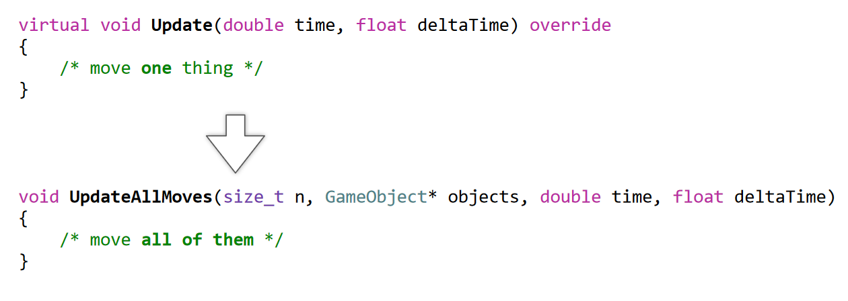
When there is One, there is Many
http://aras-p.info/texts/files/2018Academy%20-%20ECS-DoD.pdf

Slide 21
“Object composition over class inheritance”
Klasa Entity - Ne postoje podaci i funkcionalnosti u Entitetu
Klasa Component, bazna klasa za sve komponente
Entitet sadrži niz komponenti koje zapravo sadrže podatke i funkcionalnost
Lakše za razumevanje i širenje
Lako dodavanje novih koncepata bez kršenja postojećeg koda
Entity-Component arhitektura
Šta je sa sistemima?

Slide 22


ECS
Entity
Component
System

Slide 23
Možemo još bolje
Ne postoje podaci i funkcionalnosti u Entitetu
Bez metoda u komponentama, one samo sadrže podatke
Sva funkcionalnost se nalazi u Sistemima
PhysicsSystem
HealthSystem
FightSystem
RenderSystem
Sistemi operišu nad komponentama

Slide 24
Osobine ECS
Razdvajanje ponašanja i podataka u odvojene klase
Možemo da dodajemo i brišemo komponente u runtime-u
Svaka komponenta i sistem je zasebna jedinica koju možemo zasebno da testiramo
Lako za proširivanje – samo dodamo novi tip komponente i novi tip sistem
Jednostavnije za paralelizaciju
Notes:
Good decoupling, single responsibility principle: each behaviour or domain is decoupled from each other in independent components and/or systems. Unlike our monolithic god object in class based inheritance, we can extract any subset of functionality and assemble it in any combination. ECS also encourages small interfaces.
Composability and runtime object definition: Any type of game object can be created by adding the correct components to an entity. This can also allow the developer to easily add features of one type of object to another, without any dependency issues. For example, we can do Entity.build([FlyingComponent, SeeingComponent]) at runtime.
Testable: Each component and system is a unit by definition. We can also substitute components with mocked or demo components for testing.
Parallelizable: In many real-world ECS implementations such as MMOs, a System is implemented as a distributed system or a worker pool that can distribute the work amongst themselves. This lets us horizontally scale the size of our simulations by increasing the number of system workers in our pool.
Separation of data and behaviour: components hold data, systems hold behaviour. There is no intermingling of the two. This property lets you plug-and-play different behaviour to apply on the same data.

Slide 25
Osobine ECS
Kako rešiti komunikaciju između različitih komponenti?
Kako rešiti zavisnost između sistema?
Notes:
Handling interprocess communication: How do we handle the communication between systems and components? We need some kind of message bus or publish-subscribe system to enable parts of our ECS to talk to each other. Depending on the language or platform the ECS is implemented in, this could introduce a spike in complexity. The cost of iterating through components and entities may also result in a drop in performance.
Inter-component communication: What happens when a system needs to access and modify data in multiple components? Components might need to share state with other components and communicate with each other prior to communicating with systems. For example, say we have a Position and Sound component in an entity. We could have a PositionalSoundSystem that needs to communicate with both components. We may need a separate channel for inter-component communication to support this use case.
Inter-system communication: What happens when two systems need to access and modify the same component? Say we have two systems: one multiplies attribute x by -1, the other adds x by 10. Depending on the order of application of the two systems, the end result will be different. Unless the operations are associative, we may need to introduce a way to ensure that the order of the systems are correct.

Slide 26
Primeri

Slide 27
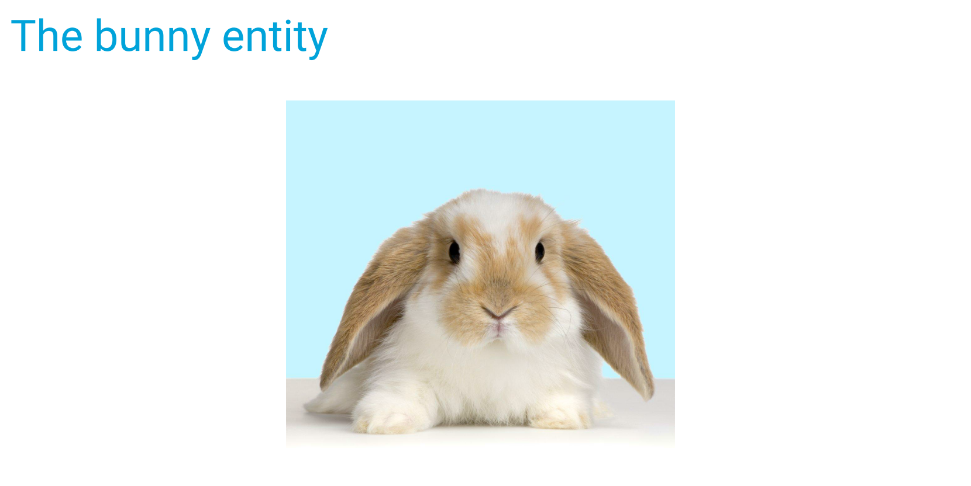

Slide 28
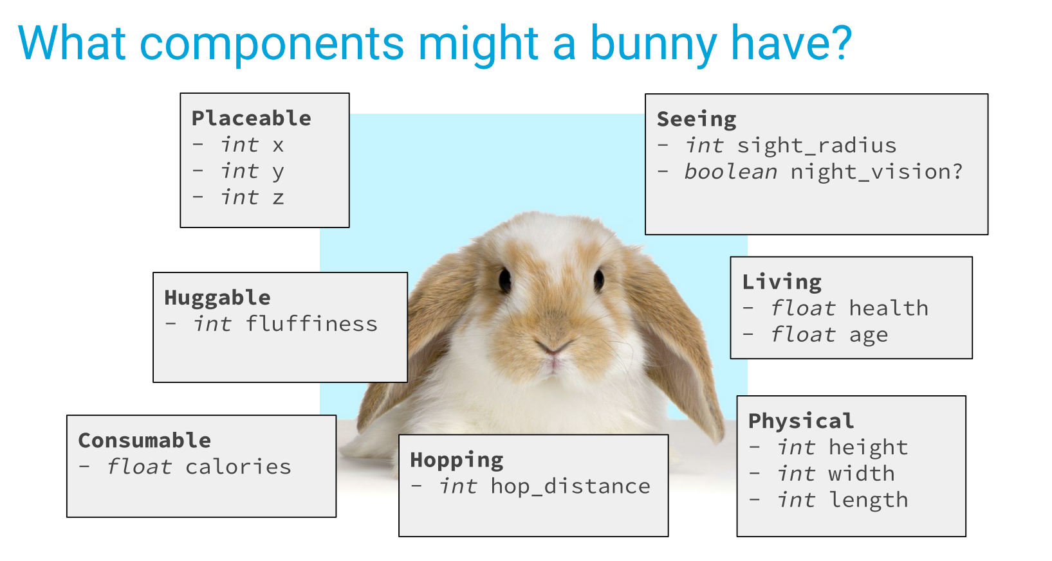

Slide 29
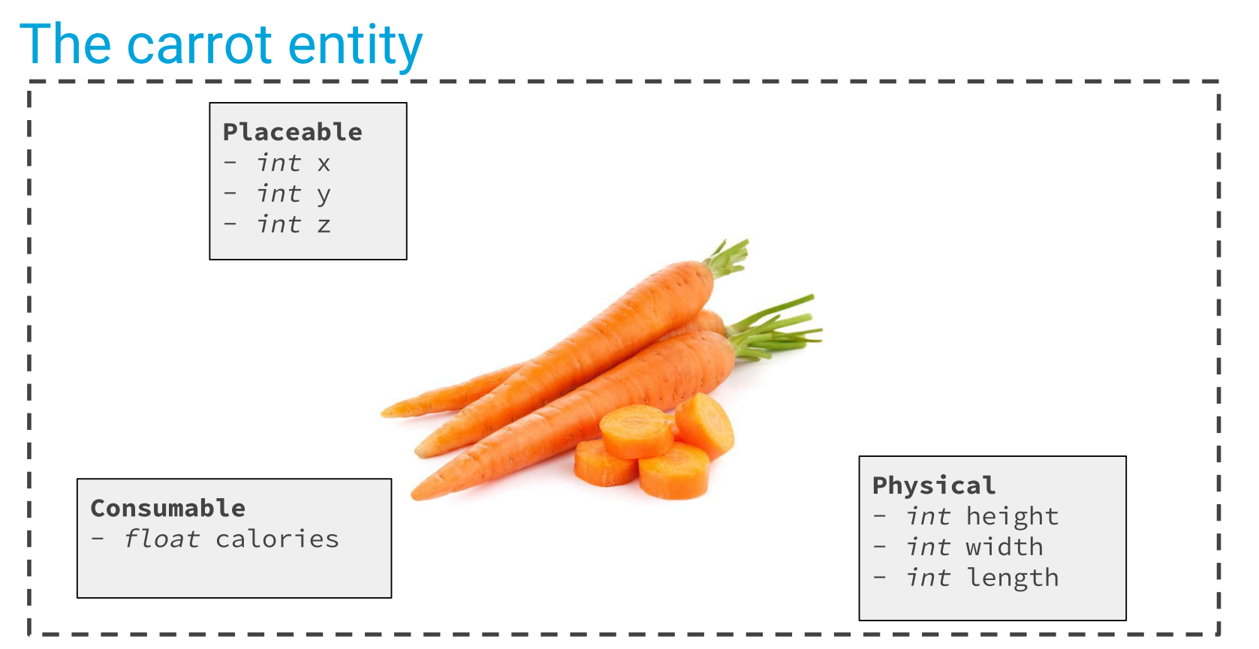

Slide 30
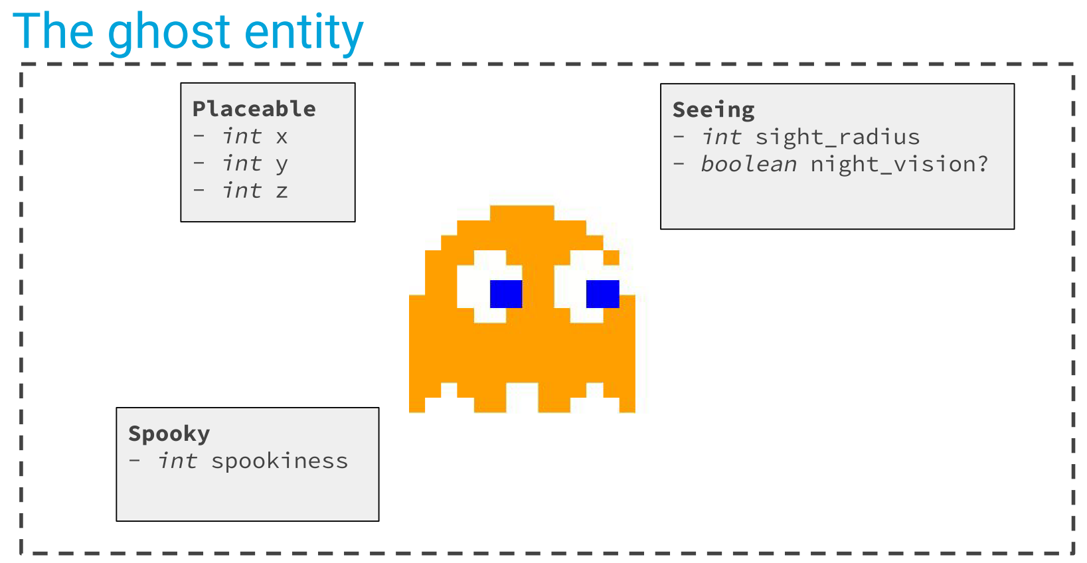

Slide 31
Komponente
Kvalitativni opis Entiteta
Mali objekti koji se sastoje samo od podataka (POD)
Nemaju ponašanje

Slide 32
Entitet
Skup komponenti
Ne sadrže direktno podatke
Ne sadrže ponašanje
Predstavljaju zbir svojih komponenti

Slide 33
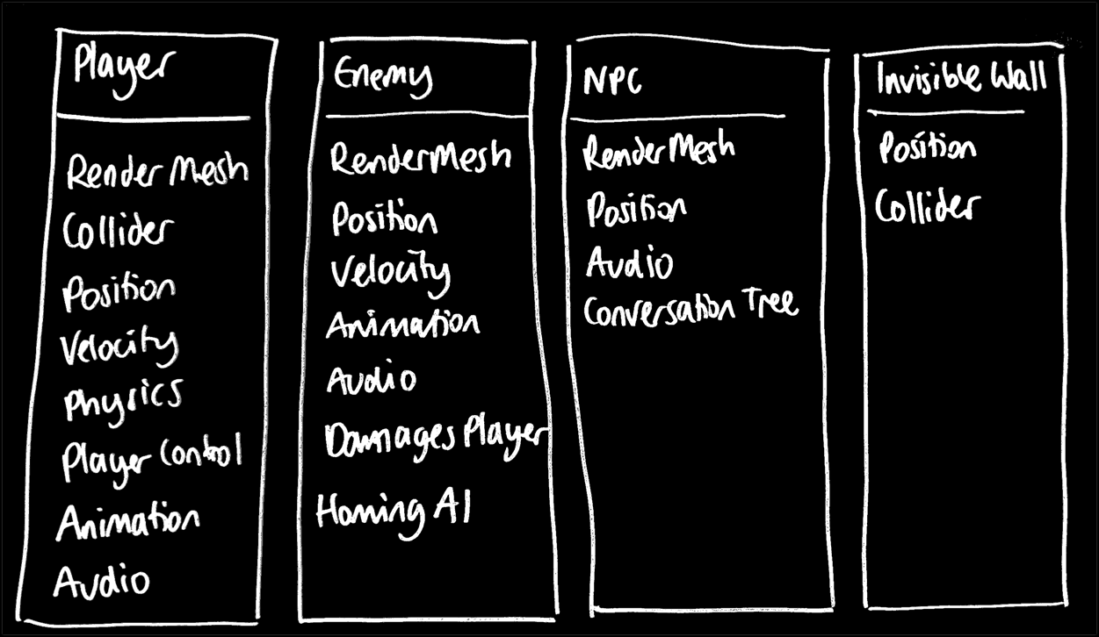

Slide 34
Sistem
Daju život entitetima i komponentama
Neprekidno iteriraju kroz sve komponente određenog tipa (ili određenih tipova)
Sistemi čitaju vrednosti iz komponenata i upisuju vrednosti u komponente

Slide 35
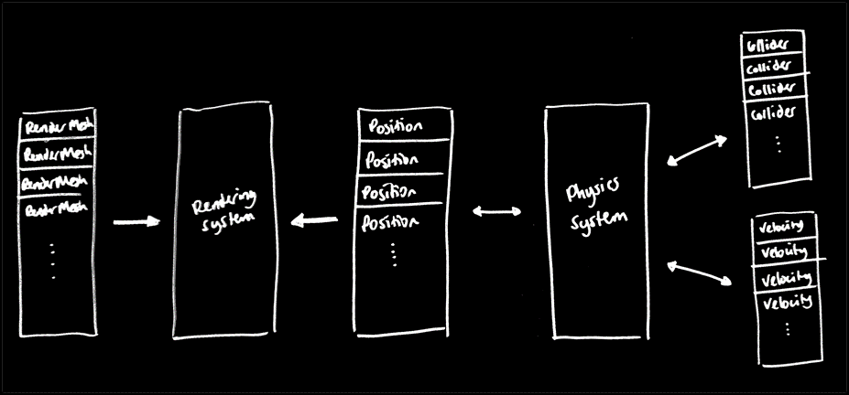

Slide 36
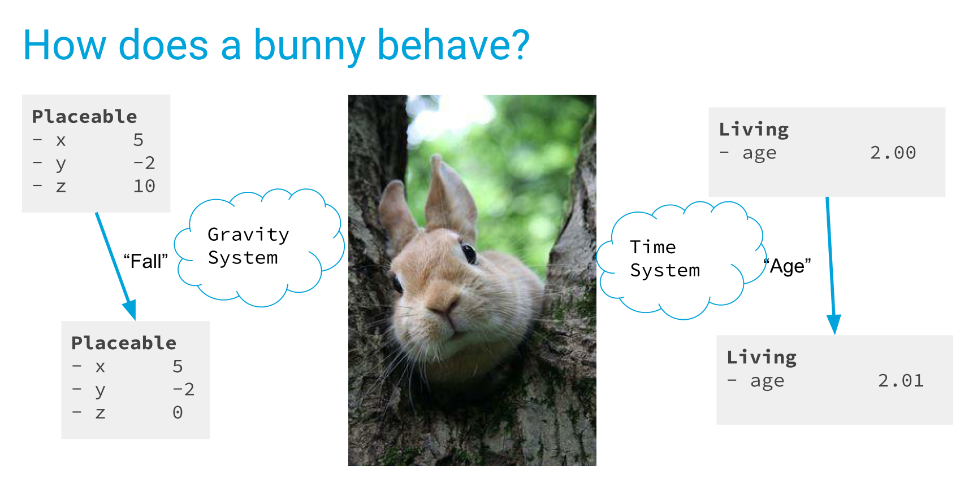

Slide 37
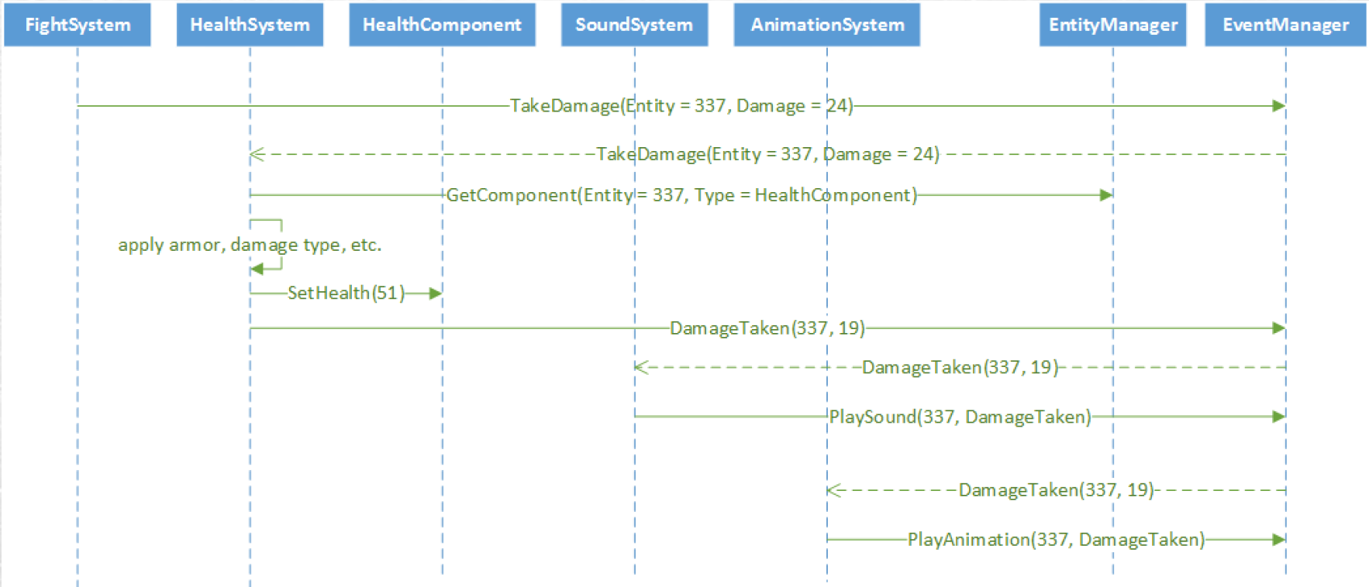

Slide 38
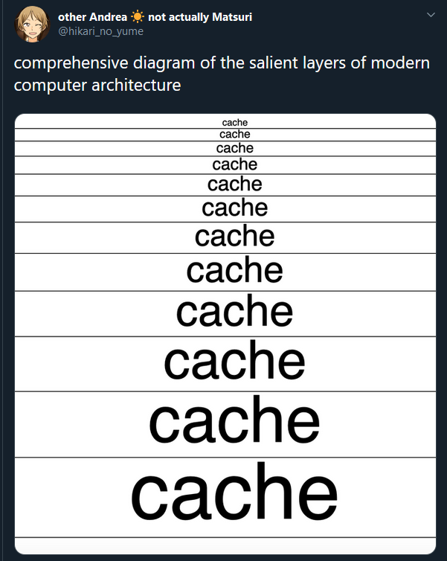
Da li možemo još bolje?

Slide 39
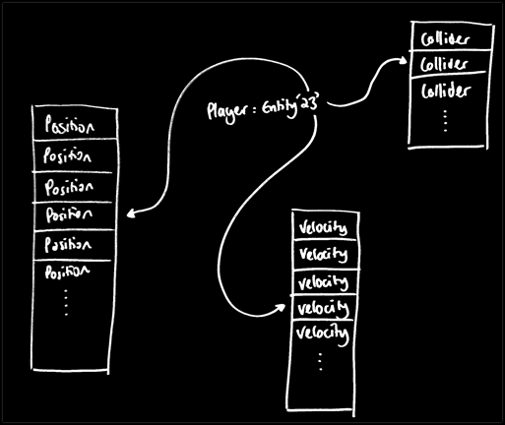
Notes:
Ovo i dalje nije potpuno optimalno rešenje sa stanja performansi. Kao primer, pokazaću vam kako možemo da odemo i korak dalje sa ovom arhitekturom, da je Entitet samo ID, a imamo nizove komponenti.
Relational database
DOD

Slide 40
Literatura
Data-Oriented Design and C++”, CppCon 2014
Overwatch Gameplay Architecture and Netcode, GDC
https://yos.io/2016/09/17/entity-component-systems/
http://bitsquid.blogspot.com/2014/08/building-data-oriented-entity-system.html
https://medium.com/ingeniouslysimple/entities-components-and-systems-89c31464240d
Entity Component System Overview in 7 Minutes
The Entity-Component-System - An awesome game-design pattern in C++ (Part 1)
https://www.slideshare.net/npruehs/game-programming-02-componentbased-entity-systems?from_action=save
CppCon 2015: Vittorio Romeo “Implementation of a component-based entity system in modern C++"
Understanding data-oriented design for entity component systems - Unity at GDC 2019
Amethyst Specs - Parallel ECS written in Rust

Slide 41
Naš ECS

Slide 42
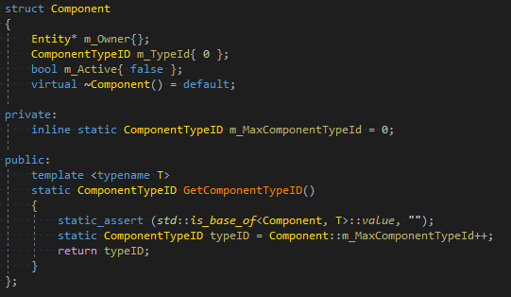
Component

Slide 43
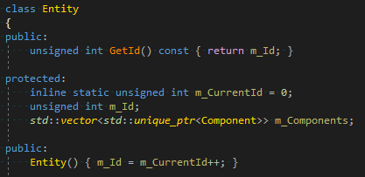
Entity

Slide 44
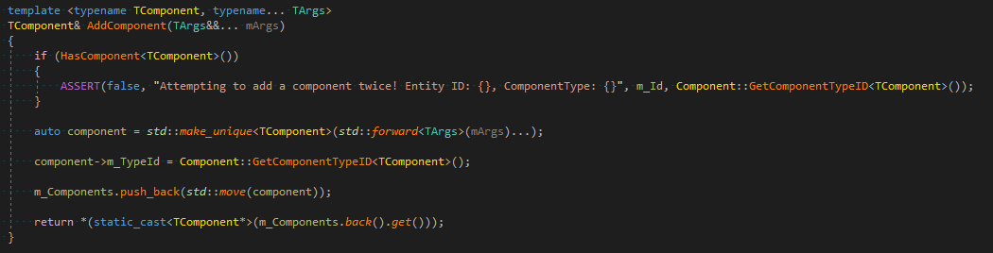
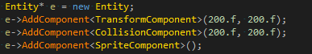
Entity::AddComponent

Slide 45
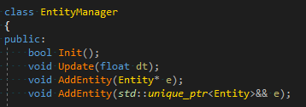
EntityManager

Slide 46
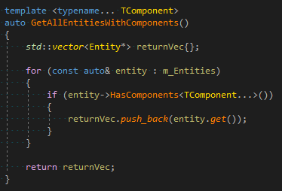
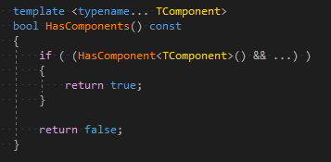
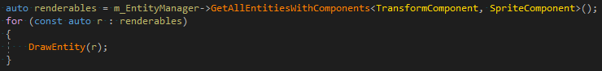
EntityManager::GetAllEntitiesWithComponents

